Slide 1
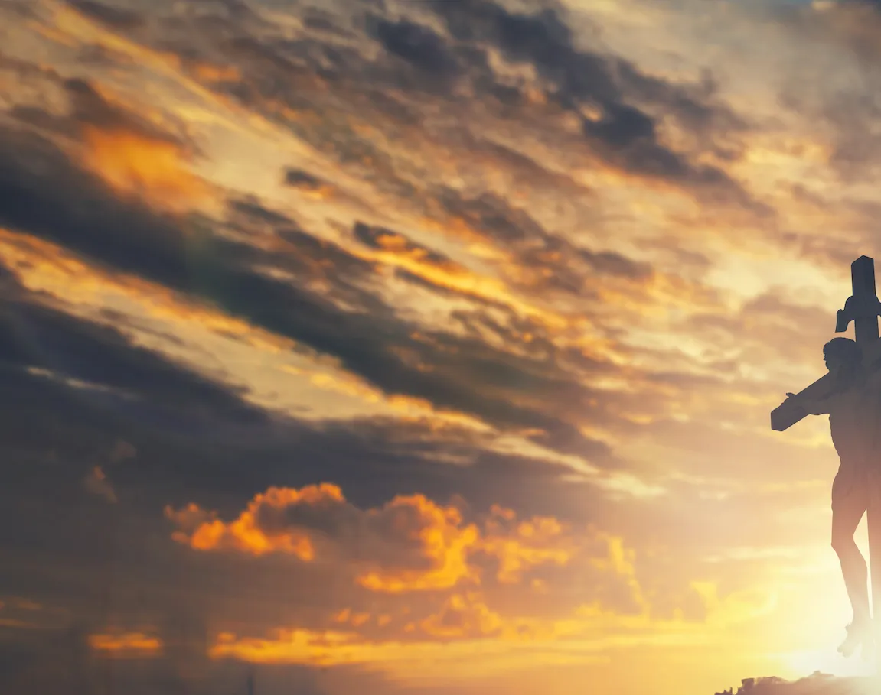
Holy Holy Holy

Slide 2
C Am G F
C G F C
Holy, holy, holy, Lord God Almighty.
G Am G D G
Early in the morning our song shall rise to Thee;
C G F C
Holy, holy, holy, Merciful and mighty
Am C F G C
God in three Persons, blessed Trinity

Slide 3
C G F C
Holy, holy, holy, All the saints adore Thee,
G Am
Casting down their golden crowns
G D G
around the glassy sea;
C G F C
Cherubim and seraphim falling down before Thee,
Am C F G C
Who was, and is, and evermore shall be

Slide 4
C Am G F C
Holy, holy, holy, Though the darkness hide Thee,
G Am G D G
Though the eye of sinful man Thy glory may not see;
C. Am G
Only Thou art holy;
F C
there is none beside Thee,
Am C F G C
Perfect in power, in love, and purity

Slide 5
C Am G F C
Holy, holy, holy, Lord God Almighty
G Am
All Thy works shall praise Thy name,
G D G
in earth, and sky, and sea;
C Am G F C
Holy, holy, holy, Merciful and mighty
Am C F G C
God in three Persons, blessed Trinity

